Slide 1
RAMP Gold Wrap
Krste Asanovic
RAMP Wrap
Stanford, CA
August 25, 2010

Slide 2
RAMP Gold Team
Graduate Students
Zhangxi Tan
Andrew Waterman
Rimas Avizienis
Yunsup Lee
Henry Cook
Sarah Bird
Faculty
Krste Asanovic
David Patterson

Slide 3
Multicore Architecture Simulation Challenge
Bigger, more complex target system
Many cores, more components, cache coherence, …
Need to run OS scheduler, or multithreaded run time
Sequential software simulator performance no longer scaling
More cores, not faster cores
Detailed software simulators don’t parallelize well
Cycle-by-cycle synchronization kills parallel performance
Parallel code has non-deterministic performance
Need multiple runs to get error bars
Software more dynamic, adaptive, autotuned, JIT, …
Can’t use sampling
~No legacy parallel software
Need to write/port entire stack.

Slide 4
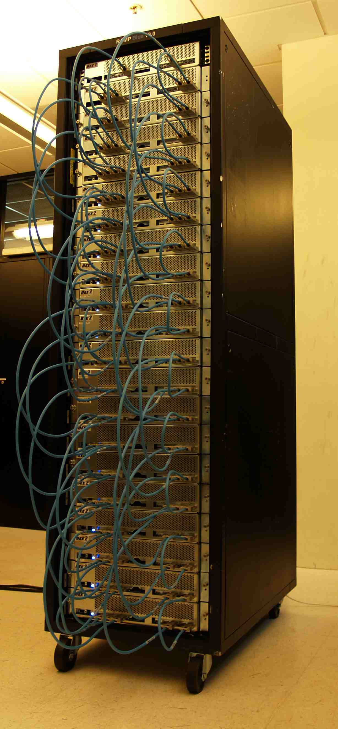
RAMP Blue, July 2007
1,008 modified MicroBlaze cores
FPU (64-bit)
RTL directly mapped to FPGA
90MHz
Runs UPC version of NAS parallel benchmarks.
Message-passing cluster
No MMU
Requires lots of hardware
21 BEE2 boards / 84 FPGAs
Difficult to modify
FPGA computer, not a simulator!

Slide 5
Dimensions in FAME (FPGA Architecture Model Execution)
Direct: One target cycle executed in one FPGA host cycle
Decoupled: One target cycle takes one or more FPGA cycles
Full RTL: Complete RTL of target machine modeled
Abstract RTL: Partial/simplified RTL, split functional/timing
Host single-threaded: One target model per host pipeline
Host multi-threaded: Multiple target models per host pipeline

Slide 6
Host Multithreading
Target Model
CPU1
CPU2
CPU3
CPU4
Multithreaded Emulation Engine (on FPGA)
PC
1
X
PC
1
GPR
I$
IR
GPR
Single hardware pipeline with multiple copies of CPU state
PC
1
GPR
PC
1
GPR
D$
Y
+1
2
2
Multithreading emulation engine reduces FPGA resource use and improves emulator throughput
Hides emulation latencies (e.g., communicating across FPGAs)

Slide 7
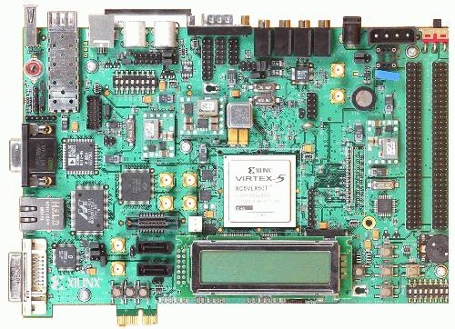
RAMP Gold, November 2009
Rapid accurate simulation of manycore architectural ideas using FPGAs
Initial version models 64 cores of SPARC v8 with shared memory system on $750 board
Hardware FPU, MMU, boots OS.
 | Cost | Performance (MIPS) | Simulations per day
Simics Software Simulator | $2,000 | 0.1 - 1 | 1
RAMP Gold | $2,000 + $750 | 50 - 100 | 100
7

Slide 8
RAMP Gold Target Machine
64 cores
SPARC V8
CORE
SPARC V8
CORE
SPARC V8
CORE
SPARC V8
CORE
…
I$
D$
I$
D$
I$
D$
I$
D$
Shared L2$ / Interconnect
DRAM
8

Slide 9
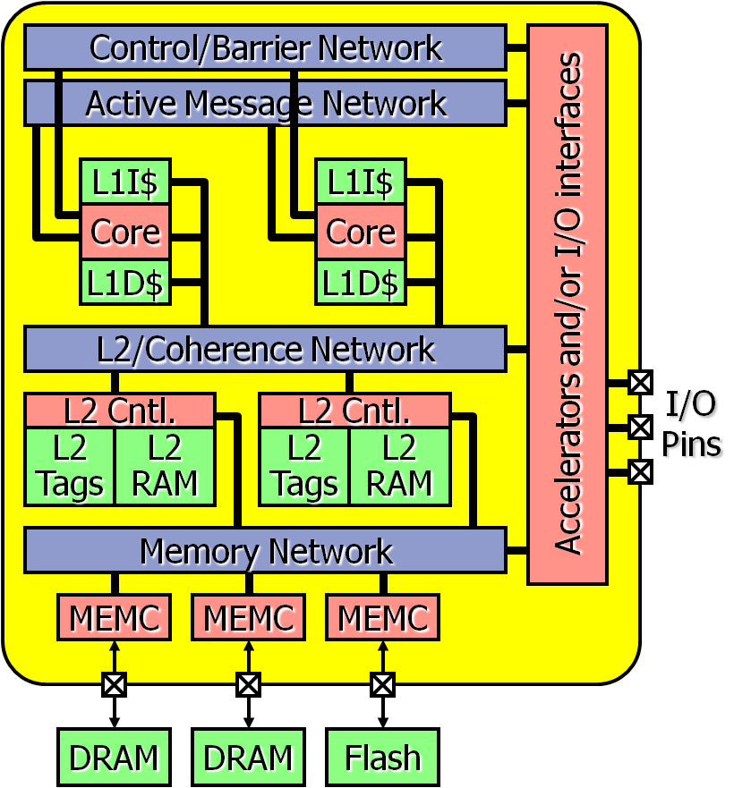
RAMP Gold Model
RAMP emulation model for Parlab manycore
SPARC v8 ISA
Single-socket manycore target
Split functional/timing model, both in hardware
Functional model: Executes ISA
Timing model: Capture pipeline timing detail (can be cycle accurate)
Host multithreading of both functional and timing models
Built for Virtex-5 systems (ML505 or BEE3)
Timing Model Pipeline
Functional Model Pipeline
Timing State
Arch State
9

Slide 10
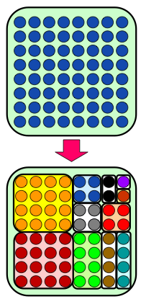
Case Study: Manycore OS Resource Allocation
Spatial resource allocation in a manycore system is hard
Combinatorial explosion in number of apps and number of resources
Idea: use predictive models of app performance to make it easier on OS
HW partitioning for performance isolation (so models still work when apps run together)
Problem: evaluating effectiveness of resulting scheduling decisions requires running hundreds of schedules for billions of cycles each
Simulation-bound: 8.3 CPU-years for Simics!
Read ISCA’10 FAME paper for details

Slide 11
Case Study: Manycore OS Resource Allocation

Slide 12
Case Study: Manycore OS Resource Allocation
The technique appears to perform very well for synthetic or reduced-input workloads, but is lackluster in reality!

Slide 13
RAMP Gold Distribution
http://sites.google.com/site/rampgold/
BSD/GNU licenses
Many (100?) downloads
Used by Xilinx tools group as exemplar System Verilog design

Slide 14
RAMP Gold Lessons
Architects will use it!
Actually, don’t want to use software simulators now
Make everything a run-time parameter
Avoid resynth + P&R
Difficult to modify highly tuned FPGA designs
Functional/Timing split should be at µarch. block level
Really build a microfunctional model
Standard ISA only gets you so far in research
Research immediately changes ISA/ABI, so lose compatibility
Target machine design vital part of architecture research
Have to understand target to build a model of it!
Need area/cycle-time/energy numbers from VLSI design
FAME-7 simulators are very complex hardware designs
Much more complicated than a processor

Slide 15
Midas Goals
Richer set of target machines
In-order scalar cores, possibly threaded, + various kinds of vector unit
Various hardware-managed plus software-managed memory hierarchies
Cross-chip and off-chip interconnect structures
More modular design
Trade some FPGA performance to make modifications easier
Better/more timing models
Especially interconnect and memory hierarchy
Better I/O for target system
Timed I/O to model real-time I/O accurately
Paravirtual-style network/video/graphics/audio/haptic I/O devices
Better scaling of simulation performance
Weak scaling – more FPGA pipelines allow bigger system to run faster
Strong scaling – more FPGA pipelines allow same system to run faster
First target machine running apps on Par Lab stack in 2010

Slide 16
Midas ISA Choice
RISC-V: A new home-grown RISC ISA
V for Five, V for Vector, V for Variants
Inspired by MIPS but much cleaner
Supports 32-bit or 64-bit address space
32-bit instruction format plus optional variable length (16/32/>32)
Designed to support easy extension
Completely open (BSD)
Are we crazy not to use a standard ISA?
Standard ISA not very helpful, but standard ABI is
Standard ABI effectively means running same OS
Running same OS means modeling hardware platform – too much work for university
Also, only interesting standard ISAs are x86 & ARM (+GPU), both are too complex for university project to implement in full
We’re going to change ISA plus OS model anyway
Midas modularity should make it easy to add other ISAs as well

Slide 17
Midas Target Core Design Space
Scalar cores
In-order (out-of-order possible later)
Different issue widths, functional-unit latencies
Decoupled memory system (non-blocking cache)
Optional multithreading
New translation/protection structures for OS support
Performance counters
Attached data-parallel accelerator options
Traditional vector (a la Cray)
SIMD (a la SSE/AVX)
SIMT (a la NVIDIA GPU)
Vector-threading (a la Scale/Maven)
All with one or more lanes
Should be possible to model mix of cores for asymmetric platforms (Same ISA, different µarchitecture)

Slide 18
Midas Uncore Design Space
Distributed coherent caches
Initially, using reverse-map tag directory
Flexible placement, replication, migration, eviction policies
Virtual local stores
Software-managed with DMA engines
Multistage cross-chip interconnect
Rings/torus
Partitioning/QoS hardware
Cache capacity
On-chip and off-chip bandwidth
DRAM access schedulers
Performance counters
All fully parameterized for latency/bandwidth settings

Slide 19
Platforms of Interest
1W – handheld
10W – laptop/settop/TV/games/car
100W – servers

Slide 20
Midas Software
Gcc+binutils as efficiency-level compiler tools
Already up and running for draft RISC-V spec
Par Lab OS + software stack for the rest
Par Lab applications
Pattern-specific compilers build with SEJITS/Autotuning help get good app performance quickly on large set of new architectures

Slide 21
Not just simulators
New DoE-funded Project Isis (with John Wawrzynek) on developing high-level hardware design capability
Integrated approach spanning VLSI design and simulation
Building ASIC designs for various scalar+vector cores
Yes, we will fab chips
Mapping RTL to FPGAs
FPGA computers help software developers, helps debug RTL
Why #1. For designing (not characterising) simple cores, power model abstractions don’t work (e.g., 2x difference based on data values).

Slide 22
Acknowledgements
Sponsors
ParLab: Intel, Microsoft, UC Discovery, National Instruments, NEC, Nokia, NVIDIA, Samsung, Sun Microsystems
Xilinx, IBM, SPARC International
DARPA, NSF, DoE, GSRC, BWRC

